Slide 1

Twitter Sentiment Analysis on Apple & Google Products
Group 1
Phase 4 NLP Project – Non-Technical Presentation

Slide 2
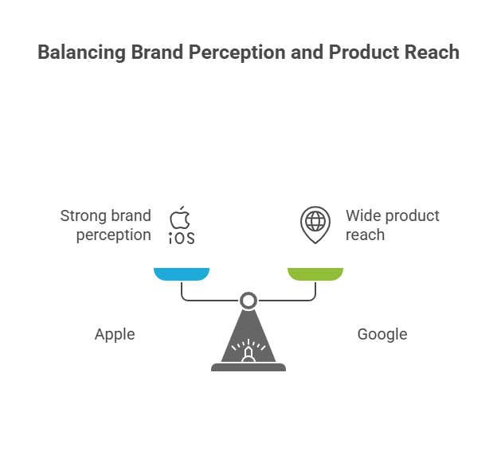
The Business Problem
• Apple and Google depend heavily on public perception.
• Tweets contain real-time feedback about their products.
• Goal: Automatically detect if tweets are Positive, Negative, or Neutral.
• Helps marketing and product teams track sentiment trends and respond quickly.

Slide 3
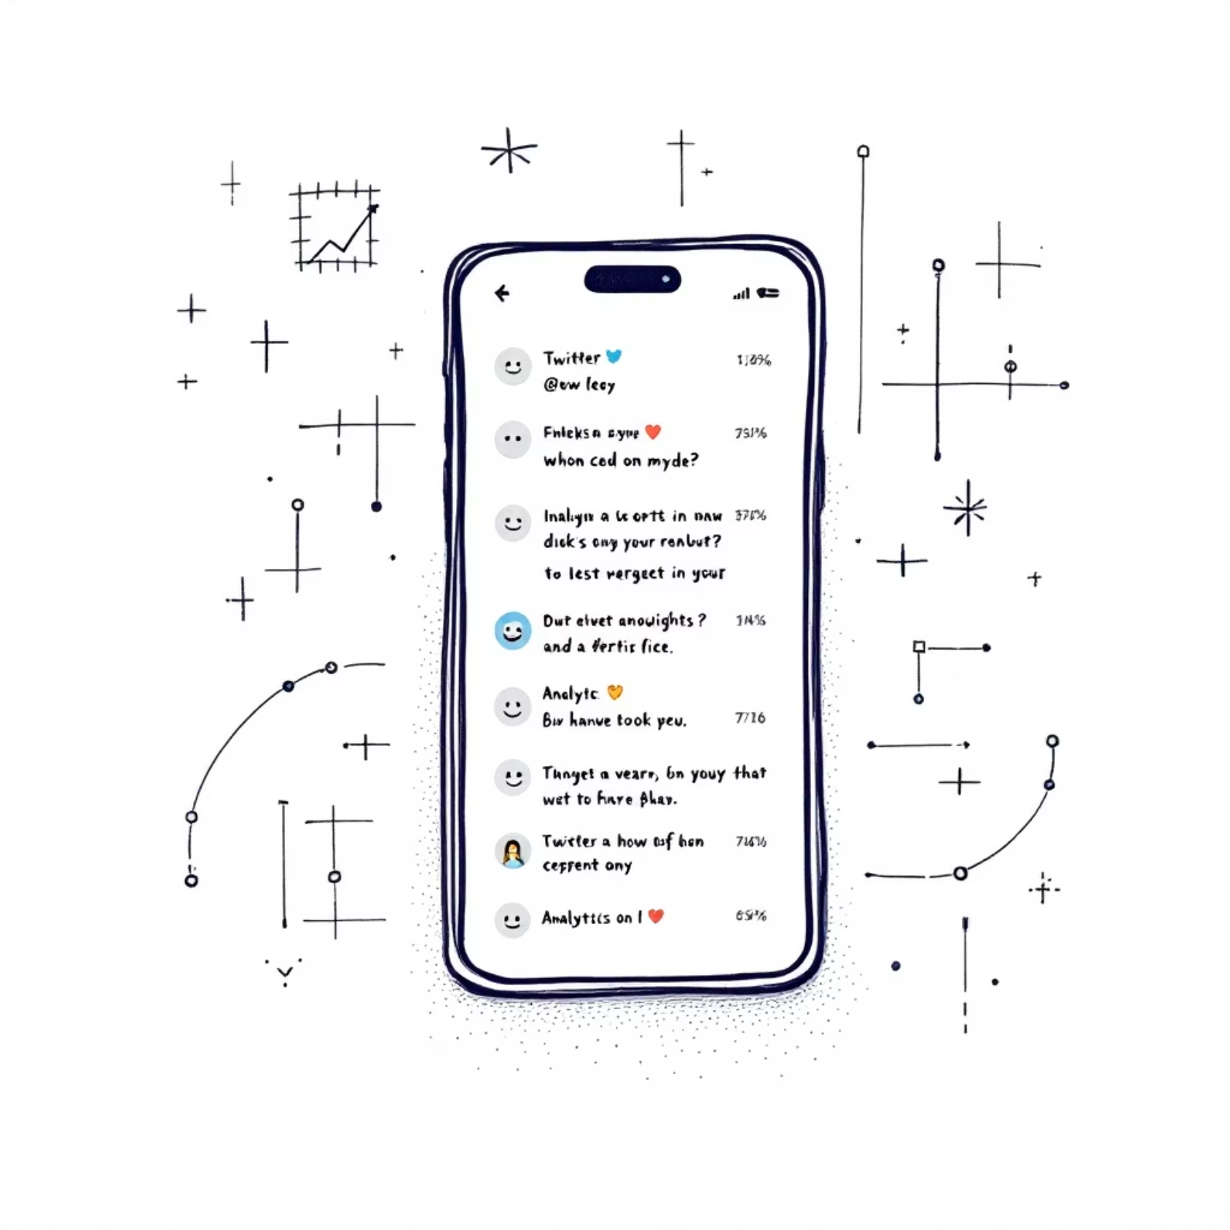
Understanding Our Data Source
• ~9,000 tweets from CrowdFlower (data.world).
• Human-labeled as Positive, Negative, Neutral.
• Tweets include brand references (Apple, Google).
• Data required cleaning (remove links, mentions, hashtags, etc.).

Slide 4
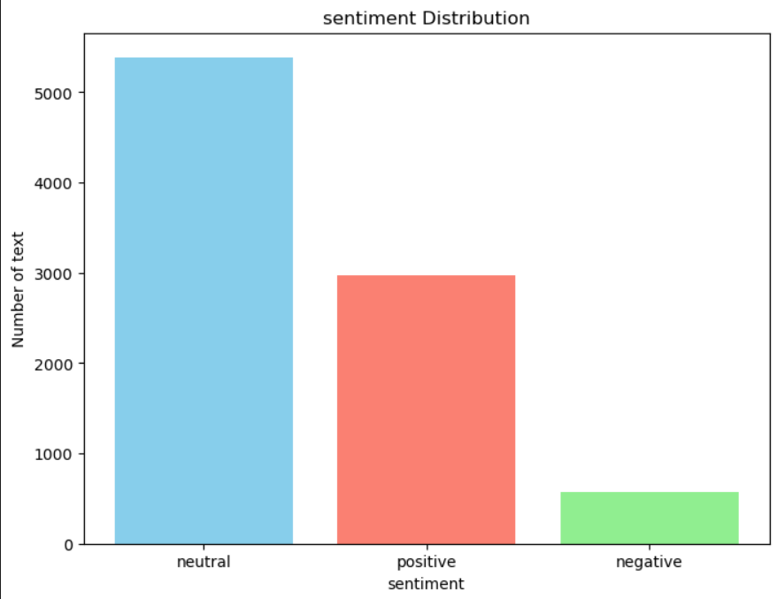
Sentiment Distribution
The dataset shows a slight imbalance: Positive tweets are the most common, followed by Neutral, with Negative tweets being the least frequent. This distribution is important for fair model training, ensuring our model doesn't overfit to the majority classes.

Slide 5
Our Analytical Approach
01
02
03
Binary Classification First
Expand to Multiclass
TF-IDF for Feature Extraction
Began by classifying tweets as just Positive or Negative to establish a baseline.
Transitioned to include Neutral, achieving the full Positive, Negative, Neutral classification.
Converted raw tweet text into numerical features using Term Frequency-Inverse Document Frequency (TF-IDF).
04
05
Model Training
Performance Evaluation
Trained various models: Logistic Regression, Naive Bayes, and Support Vector Machine (SVM).
Assessed model accuracy using Macro F1-score and analyzed performance with Confusion Matrices.

Slide 6
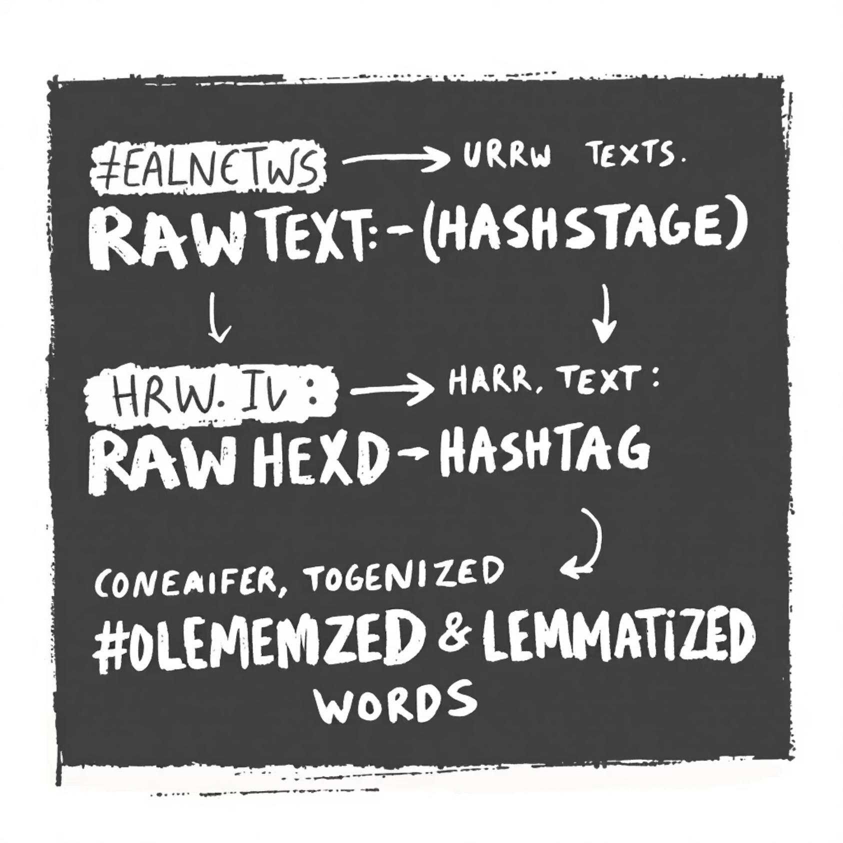
Text Preprocessing: Cleaning the Data
This process ensures that only relevant linguistic features are considered, improving model accuracy.
• Removed URLs, mentions (@user), hashtags (#tag → tag).
• Converted text to lowercase and cleaned symbols.
• Used NLTK for:
– Tokenization (splitting into words).
– Stopword removal (ignored filler words like 'the', 'is').
– Lemmatization (reduce words to base form).

Slide 7
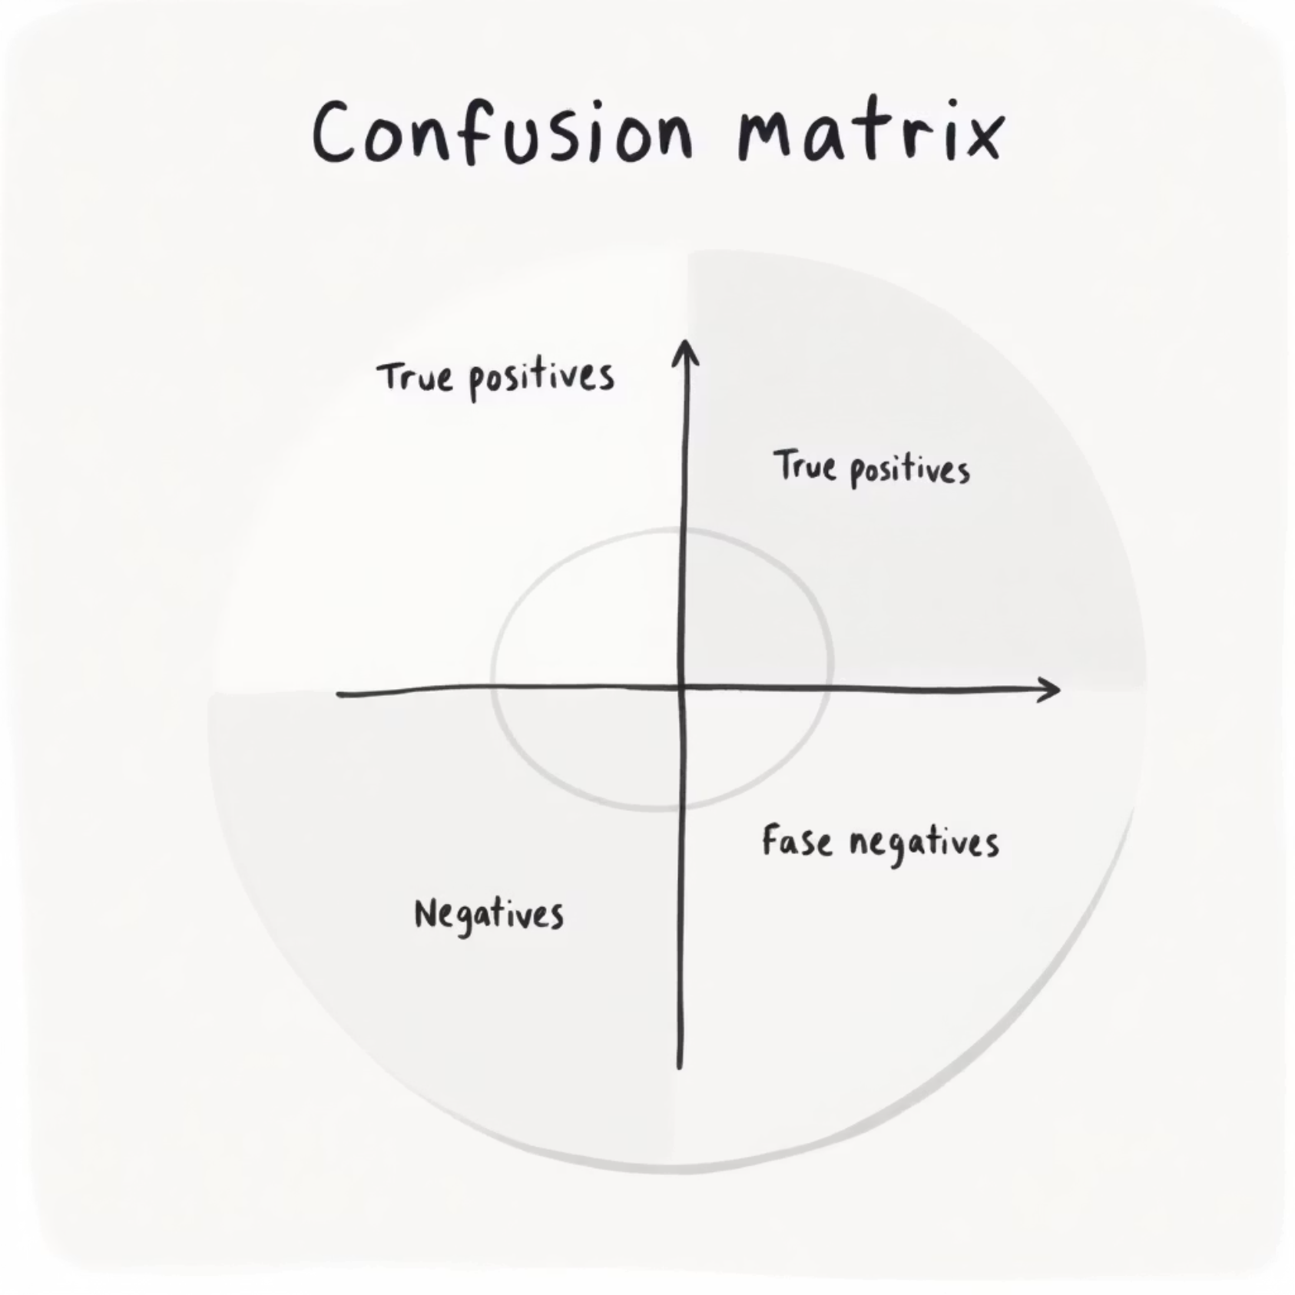
Model Results (Validation)
• Logistic Regression and Naive Bayes performed well for binary.
• Linear SVM (Support Vector Machine) worked best for multiclass.
• Macro F1-score chosen to give equal weight to all classes.
• Confusion matrix showed most errors between Neutral and Positive.

Slide 8




Business Insights from Sentiment Analysis
Balanced Feedback
Early Issue Detection
Both Apple and Google consistently receive a mix of positive and negative feedback across their product lines.
The model effectively identifies spikes in negative tweets, serving as an early warning system for potential product or service issues.
Positive Sentiment Drivers
Negative Sentiment Drivers
Commonly, positive words relate to product features like "camera," "design," and "apps," indicating successful areas.
Conversely, negative words frequently mention "battery life," "software updates," and "bugs," highlighting pain points for users.

Slide 9




Recommendations for Implementation
Real-Time Monitoring
Shareable Dashboards
Deploy the sentiment model to continuously monitor Twitter sentiment as it happens, enabling immediate action.
Create intuitive dashboards to visualize sentiment trends for Marketing and Customer Support teams, making insights accessible.
Automated Alerts
Continuous Refinement
Implement automated alerts that notify relevant teams when negative sentiment spikes, allowing for rapid response to emerging issues.
Regularly refine the model with new training data, and integrate handling for emojis and slang to improve accuracy and relevance.

Slide 10

Conclusion & Future Outlook
• Proof of concept shows NLP can track public sentiment.
• Helps businesses react faster to customer concerns.
• Future: Extend to other brands, include emoji/emotion analysis.
• Business takeaway: Turn social media noise into actionable insights.

Slide 11
Thank You
Prepared By Group 1 Collaborators
Anthony Muthee Njiru
Beth Mwangi
Edwin Joshua
Kelvin Shilisia
Mercy Chebet
Mirriam David

